Slide 1
agnelo.menezes@xaviers.edu
REGRESSION
9220439704

Slide 2
Regression converts data clumps into comprehensible information
To understand the implications of
Y = f (X)
Bi-Variate Function
We must investigate into the impact of:
the REGRESSOR (independent or causal) variable (X)
on the concerned
REGRESSAND (dependent or affected) variable (Y)
Y = f (X₁, X₂, … X_{N})
Multi-Variate Function

Slide 3
independent variable (X)
dependent variable (Y)
PREDETERMINED Variable
DETERMINED Variable
Serves as:
the cause
or the stimulant
Serves as:
the effect
or the consequence
Y is also called a STOCHASTIC Variable since ...

Slide 4
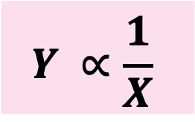
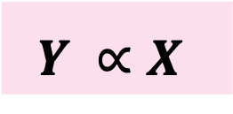


The functional relationship Y = f (X) could either be:
$$Y ∝X$$
Negative / Indirect / Inverse:
$$Y ∝\frac{1}{X}$$
Positive / Direct:
X Y
X Y
$$OR$$
$$OR$$
X Y
X Y
Slope: Positive
Trajectory: UPWARD SLOPING
Slope: Negative
Trajectory: DOWNWARD SLOPING
Y
Y
EFFECT
EFFECT
CAUSE
X
CAUSE
X

Slide 5
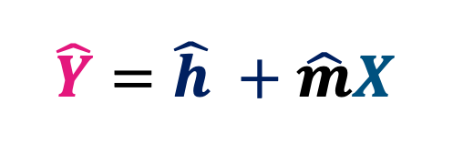
Regression (contd.)
Data can be converted into an equation, which will indicate the curve’s:
TRAJECTORY and VALUE OF THE SLOPE
Via Regression data can be converted into a LINEAR equation
Y = mX + h OR Y = h + mX
PRF
$$\hat{Y}=\hat{h} +\hat{m}X$$
SRF
What is the significance of ‘h’ ???

Slide 6
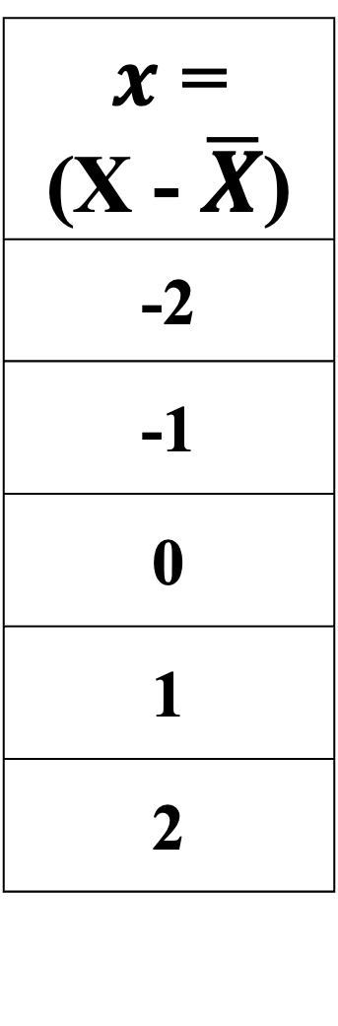
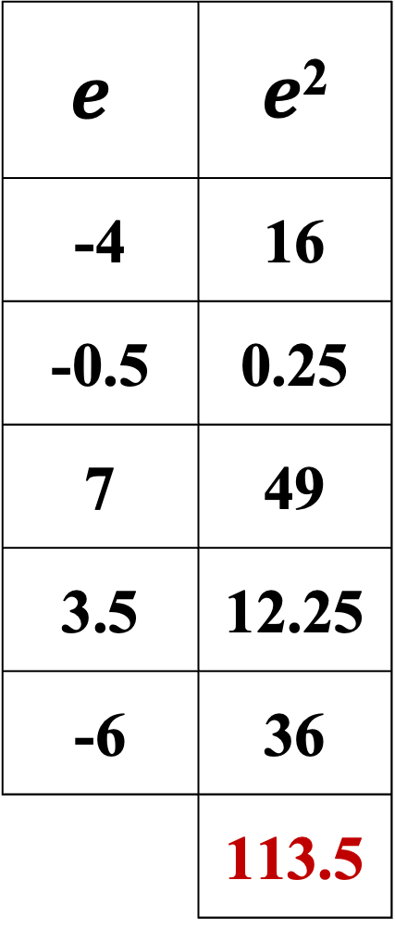
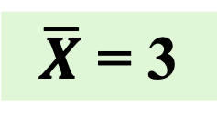
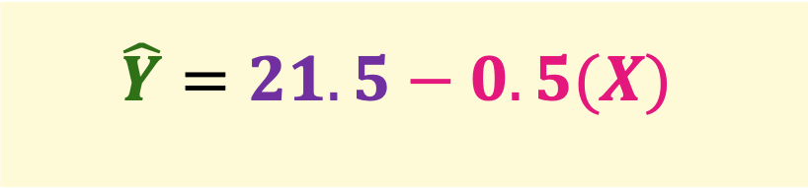
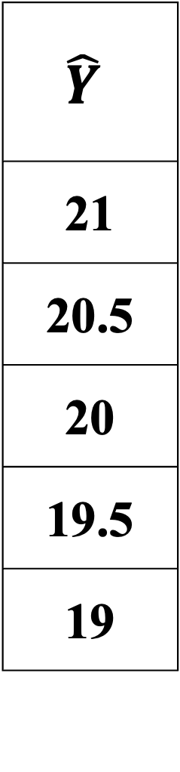
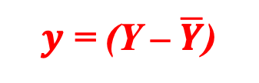
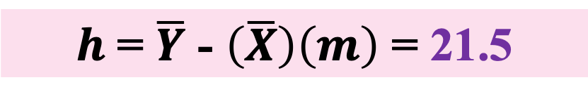
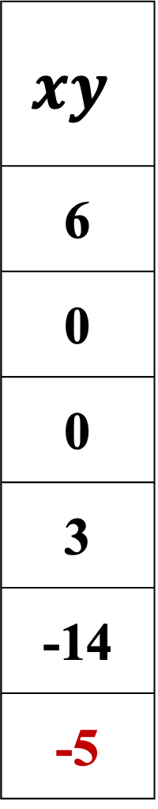
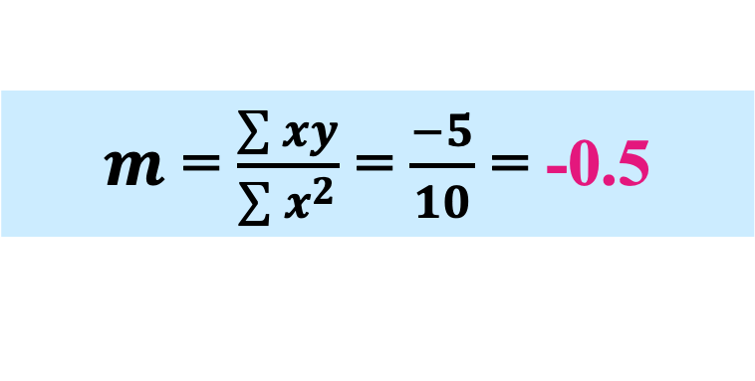
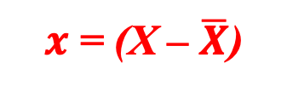
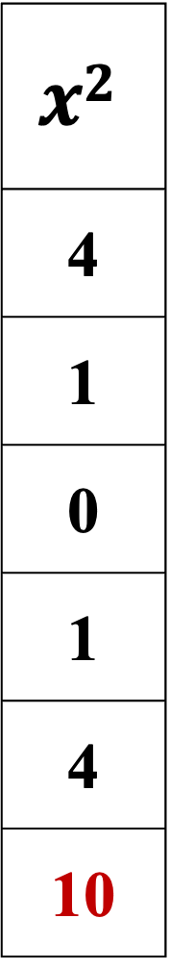
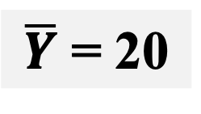
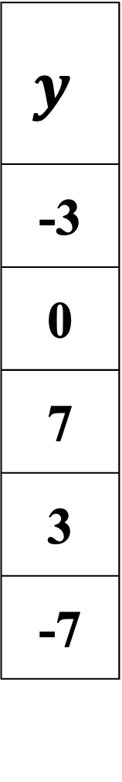
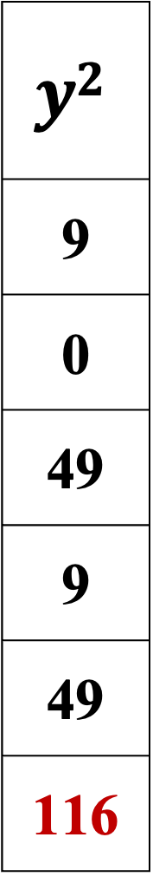
$x$ = (X – $\overline{X}$)
$y$ = (Y – $\overline{Y}$)
X | Y
1 | 17
2 | 20
3 | 27
4 | 23
5 | 13
15 | 100
$x$ = (X - $\overline{X}$)
-2
-1
0
1
2
$$y$$
-3
0
7
3
-7
$$xy$$
6
0
0
3
-14
-5
$$x2$$
4
1
0
1
4
10
$$\hat{Y}$$
21
20.5
20
19.5
19
$$e$$ | $e$²
-4 | 16
-0.5 | 0.25
7 | 49
3.5 | 12.25
-6 | 36
 | 113.5
$$y2$$
9
0
49
9
49
116
$\overline{X}$ = 3
$m$ = $\frac{\sum{xy}}{\sum{x^{2}}}$ = $\frac{−5}{10}$ = -0.5
$$\hat{Y}=21.5−0.5(X)$$
$\overline{Y}$ = 20
$h$ = $\overline{Y}$ - $\left(\overline{X}\right)\left(m\right)$ = 21.5

Slide 7
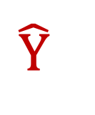
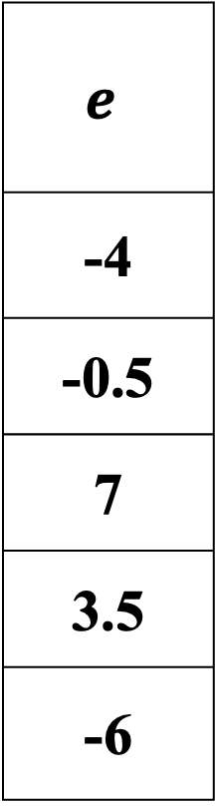
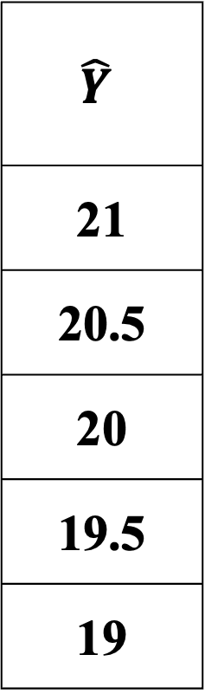
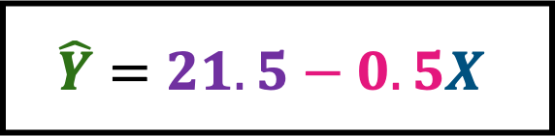
X
1
2
3
4
5
Y
17
20
27
23
13
$$\hat{Y}$$
21
20.5
20
19.5
19
$$e$$
-4
-0.5
7
3.5
-6
Y
$$\hat{Y}$$
$$\hat{Y}=21.5−0.5X$$
X
1
2
3
4
5

Slide 8
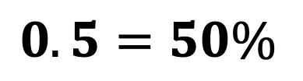



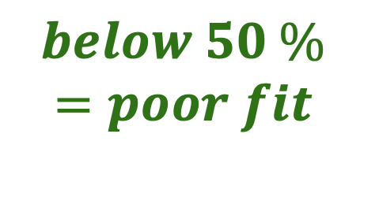
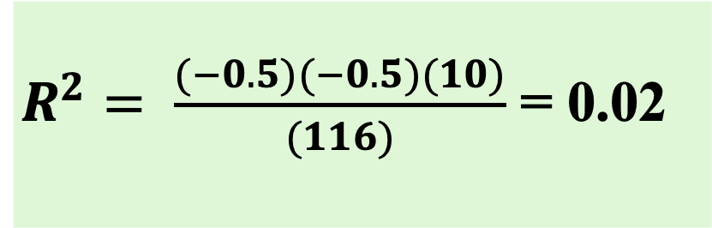
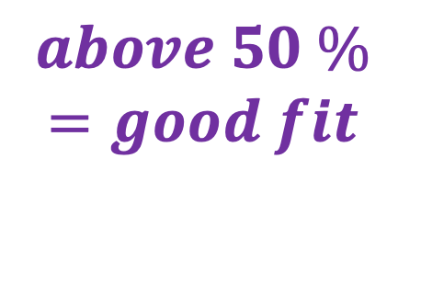
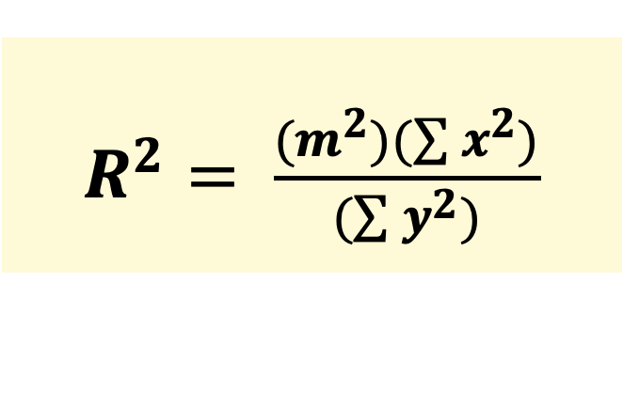

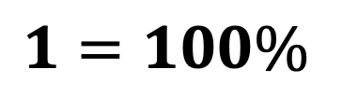
(R²) Coefficient of Determination of Goodness of Fit
$$0≤R^{2}≤1$$
$$0$$
$$0.5=50\%$$
$$1=100\%$$
$$below 50 \%$$
$$=poor fit$$
$$above 50 \%$$
$$=good fit$$
$$50 \%$$
$$=benchmark$$
$R^{2}= \frac{(m^{2})(\sum{x^{2})}}{(\sum{y^{2})}}$
Y
$$\hat{Y}$$
$R^{2}= \frac{(−0.5)(−0.5)(10)}{(116)}$ = 0.02
For the given data R² = 0.02 or 2%
1
2
3
4
5
X
Hence, X cannot explain 98 % of Y’s behaviour

Slide 9
X | 10 | 21 | 32 | 45 | 52
Y | 06 | 31 | 21 | 12 | 40
Kudos Points = Brownie Points = 0.25 (max. 3 pts)

Slide 10
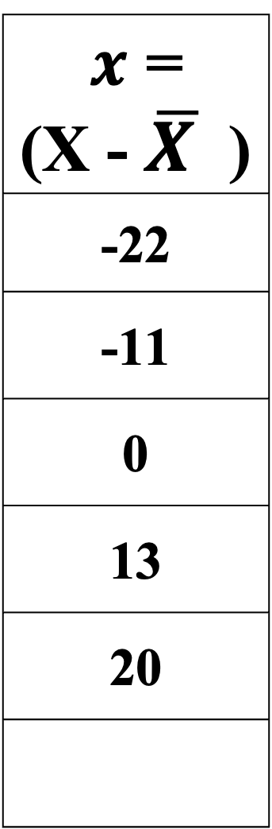
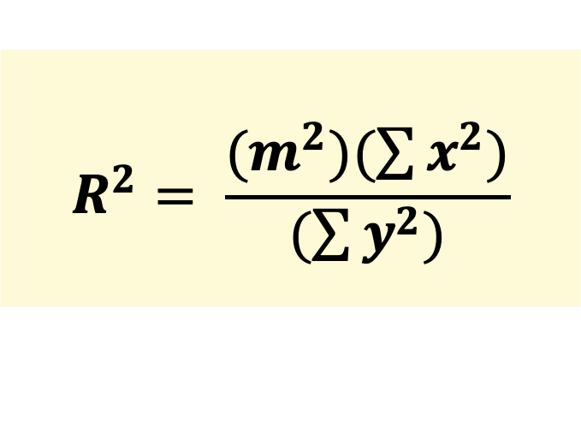
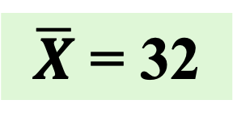
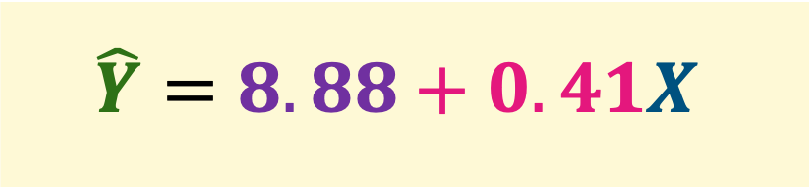
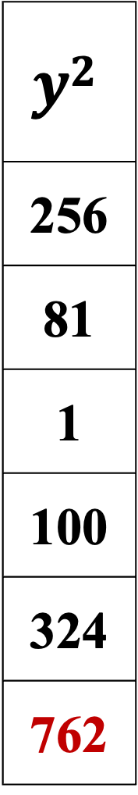
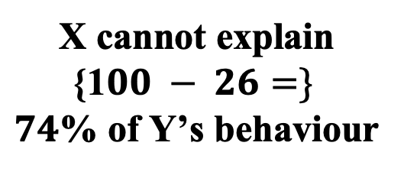
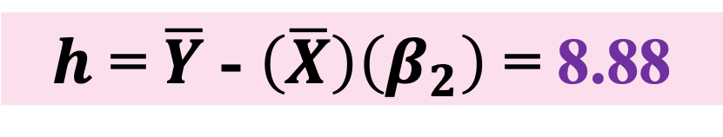
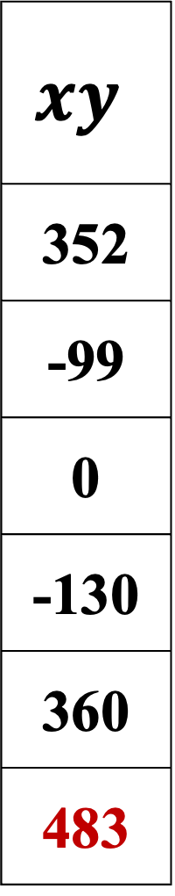
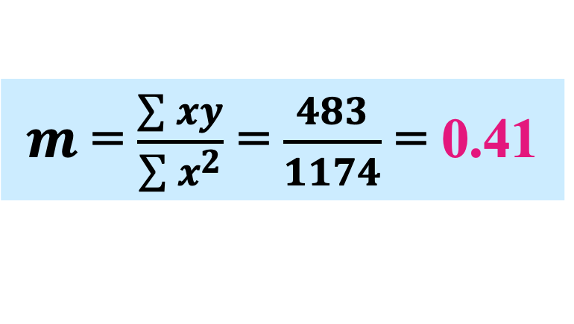
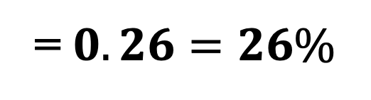
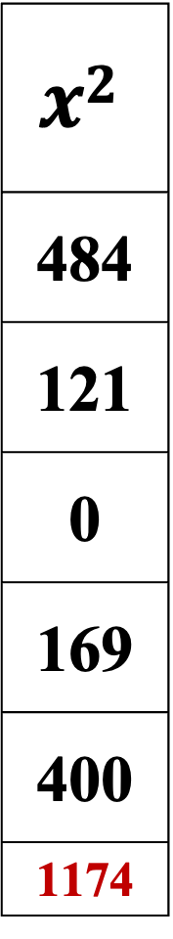
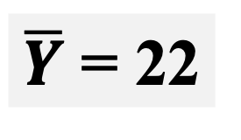
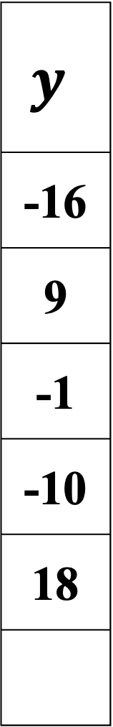
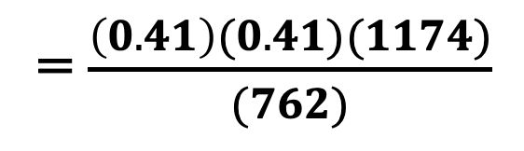
Regression (contd.)
X | Y
10 | 06
21 | 31
32 | 21
45 | 12
52 | 40
160 | 110
$x$ = (X - $\overline{X }$ )
-22
-11
0
13
20
$$y$$
-16
9
-1
-10
18
$$xy$$
352
-99
0
-130
360
483
$$x2$$
484
121
0
169
400
1174
$$y2$$
256
81
1
100
324
762
$$R^{2}= \frac{(m^{2})(\sum{x^{2})}}{(\sum{y^{2})}}$$
= $\frac{\left(0.41\right)(0.41)(1174)}{(762)}$
= $0.26=26\%$
X cannot explain
{1$00 − 26=\}$
$74$% of Y’s behaviour
$\overline{X}$ = 32
$m$ = $\frac{\sum{xy}}{\sum{x^{2}}}$ = $\frac{483}{1174}$ = 0.41
$$\hat{Y}=8.88+0.41X$$
$\overline{Y}$ = 22
$h$ = $\overline{Y}$ - $\left(\overline{X}\right)\left(β_{2}\right)$ = 8.88

Slide 11
REGRESSION and ELASTCITY

Slide 12
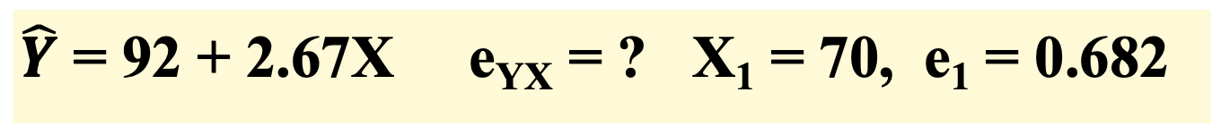
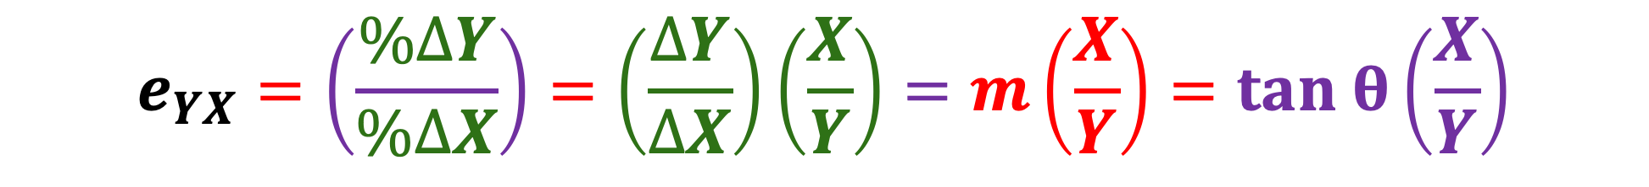
Regression and Elasticity of Y on X
$$e_{YX}=\left(\frac{\%∆Y}{\%∆X}\right)=\left(\frac{∆Y}{∆X}\right)\left(\frac{X}{Y}\right)=m\left(\frac{X}{Y}\right)=tan θ\left(\frac{X}{Y}\right)$$
Relatively Elastic: $\%∆Y>\%∆X implication e>1$
Relatively INElastic: $\%∆Y<\%∆X implication e<1$
Unitary Elastic: $\%∆Y=\%∆X implication e=1$
Perfectly INElastic: $\%∆Y=0 \& \%∆X>0 implication e=0$
$\hat{Y}$ = 92 + 2.67X e_{YX} = ? X₁ = 70, e₁ = 0.682

Slide 13








Regression and Elasticity of X on Y
Y
$$∆ Y1$$
$$∆ Y2$$
$$∆ Y2$$
$$∆ X$$
$$∆ X$$
$$∆ X$$
$$∆ Y1$$
RIE
$$∆ X$$
RE
A
B
$$∆ X$$
X

Slide 14









Regression and Elasticity of X on Y
Y
RE
$$∆ Y2$$
RIE
$$∆ X$$
$$∆ Y1$$
$$∆ Y1$$
$$∆ X$$
$$∆ Y2$$
$$∆ X$$
$$∆ X$$
$$∆ X$$
X

Slide 15
CONCAVITY and CONVEXITY + INFLEXION lvn5kw2

Slide 16
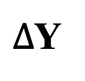
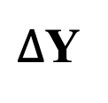

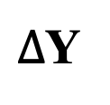
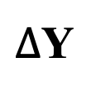



Concave to X-Axis Downwards
Convex to X-Axis Downwards
Y
Y
For more of X we give up
more & more of Y
For more of X we give up
Less & less of Y
$∆$Y
$∆$Y
$∆$Y
$∆$Y
$∆$Y
$∆$Y
$∆$Y
$∆$Y
$∆$Y
$∆$Y
$∆$Y
X
X

Slide 17








Concave to X-Axis Upwards
Convex to X-Axis Upwards
Y
Y
For more of X we get
less & less addition of Y
For more of X we get
more & more addition of Y
$∆$Y
$∆$Y
$∆$Y
$∆$Y
$∆$Y
$∆$Y
$∆$Y
$∆$Y
$∆$Y
$∆$Y
$∆$Y
$∆$Y
$∆$Y
$∆$Y
X
X

Slide 18

Concave to X-Axis Upwards
Convex to X-Axis Upwards
Y
Y
For more of X we get
less & less addition of Y
For more of X we get
more & more addition of Y
$∆$Y
$∆$Y
$∆$Y
$∆$Y
$∆$Y
$∆$Y
$∆$Y
$∆$Y
$∆$Y
$∆$Y
$∆$Y
$∆$Y
$∆$Y
$∆$Y
X
X

Slide 19









Concave to X-Axis Upwards
Concave to X-Axis Downwards
For more of X we give up
more & more of Y
Y
For more of X we get
less & less increment in Y
Y
$∆$Y
$∆$Y
$∆$Y
$∆$Y
$∆$Y
$∆$Y
$∆$Y
$∆$Y
$∆$Y
$∆$Y
$∆$Y
$∆$Y
X
X

Slide 20
A
6
B
4
C
2
A
6
C
2
Points of INFLEXION
C
2
B
4
A
Model 3
6
Model 4
Model 5
Model 6
B
4
D
A
6
C
2
E
G
Model 1
Model 2
H
No INFLEXION Points
Model 7
J
F
Model 8

